Slide 1
File and Data Management
Jing Su
20180223

Slide 2
What You Will Learn
Why file management of your research data is important
Specific techniques for organizing your research data,
– File structures
– File naming
– Version control
- Storage & Backup
Including:
– Small group discussion
– Exercise for organizing your own data
Focuses on research data, also applies to other types of files
Notes:
Why file organization of your research data is important
Specific techniques for organizing your research data,
including developing plans for:
– File structures - where to put data so you won’t lose it
(including tips on embedding metadata)
– File naming - what to call data so you know what it is
– A bit on version control - keeping track of data
• Will also include opportunities for:
– Small group discussion
– Exercise for organizing your own data
• Focuses on research data, but applies to other types of files as well

Slide 3
Small Group Discussion
• What kind of data do you work with?
• What organizational challenges have you faced?
• What tools or techniques work for you?
Notes:
Why file organization of your research data is important
Specific techniques for organizing your research data,
including developing plans for:
– File structures - where to put data so you won’t lose it
(including tips on embedding metadata)
– File naming - what to call data so you know what it is
– A bit on version control - keeping track of data
• Will also include opportunities for:
– Small group discussion
– Exercise for organizing your own data
• Focuses on research data, but applies to other types of files as well

Slide 4
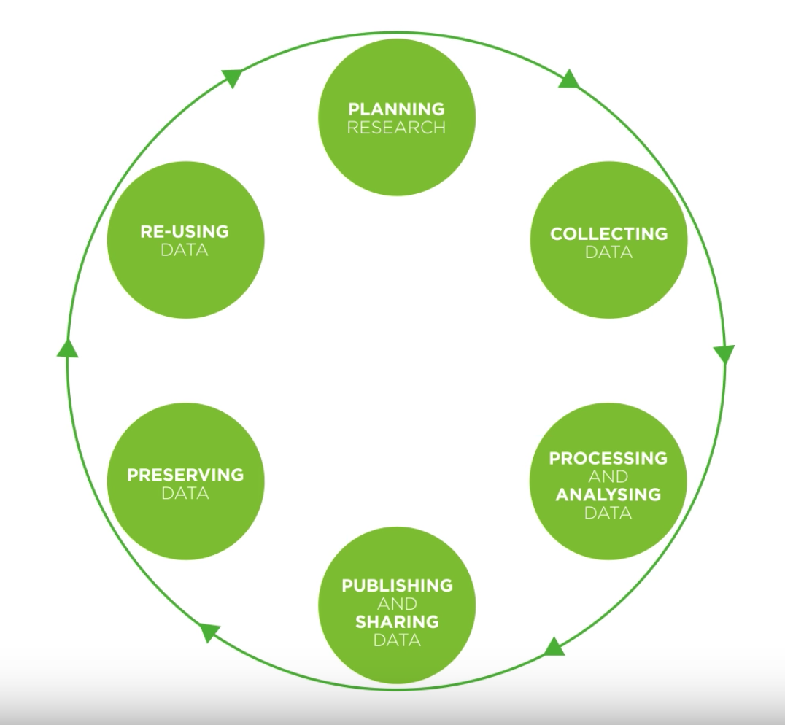
Research Data Lifecycle
Lifecycle: https://www.youtube.com/watch?v=-wjFMMQD3UA&feature=youtu.be
Notes:
- Diagram to explain when to collect and how the data is used through the project etc..
- Data management plan, checklist

Slide 5
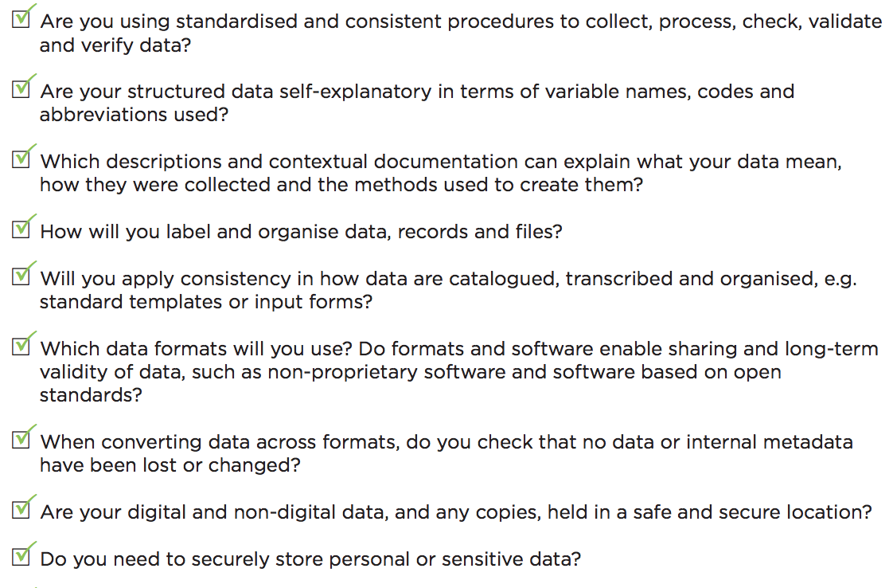
Data Management Checklist 1/2
Notes:
Why file organization of your research data is important
Specific techniques for organizing your research data,
including developing plans for:
– File structures - where to put data so you won’t lose it
(including tips on embedding metadata)
– File naming - what to call data so you know what it is
– A bit on version control - keeping track of data
• Will also include opportunities for:
– Small group discussion
– Exercise for organizing your own data
• Focuses on research data, but applies to other types of files as well

Slide 6
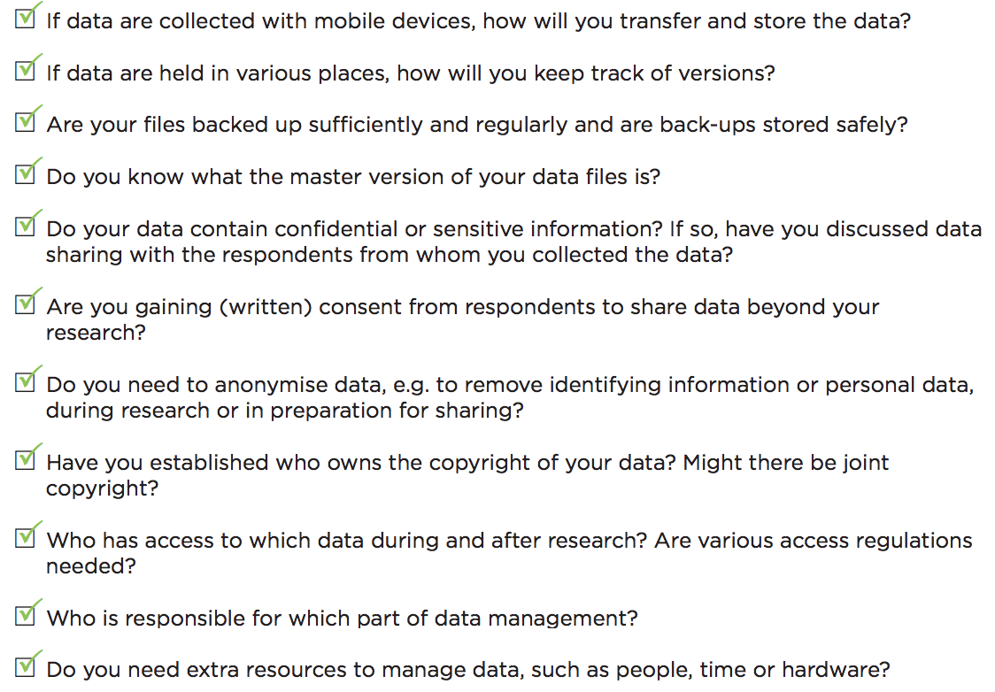
Data Management Checklist 2/2
Notes:
Why file organization of your research data is important
Specific techniques for organizing your research data,
including developing plans for:
– File structures - where to put data so you won’t lose it
(including tips on embedding metadata)
– File naming - what to call data so you know what it is
– A bit on version control - keeping track of data
• Will also include opportunities for:
– Small group discussion
– Exercise for organizing your own data
• Focuses on research data, but applies to other types of files as well

Slide 7
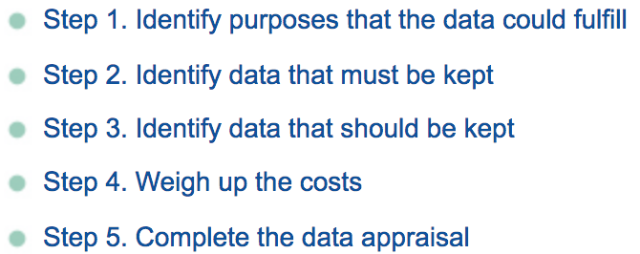
Data Management Checklist
What types of data and for how long?
Five steps to decide what data to keep
• Who will be responsible to collect and document the data?
Roles and responsibilities. Legal and ethical obligations and right. Plan and consent to share.
• How to document different types of data?
Study-level, Data-level, and Metadata
Wet lab: Electronic Lab Notebook (ELN)
Computational: large size sequencing data, consortium data (TCGA, ICGC)
Notes:
1.1 Data type and sources
- What types of data, samples, physical collections, code, software, curriculum materials
and other materials will be produced in the course of the project?
- including a brief description of each type of data to be generated, e.g. experimental,
qualitative, raw, processed
- Which data you will share and at what stage (raw, processed, reduced, analyzed)
- if you are using data from other sources, provide a brief description, including content,
source, any any conditions required for obtaining and using that data. If you combine existing
data with your own, describe the relationship between the data sets.

Slide 8
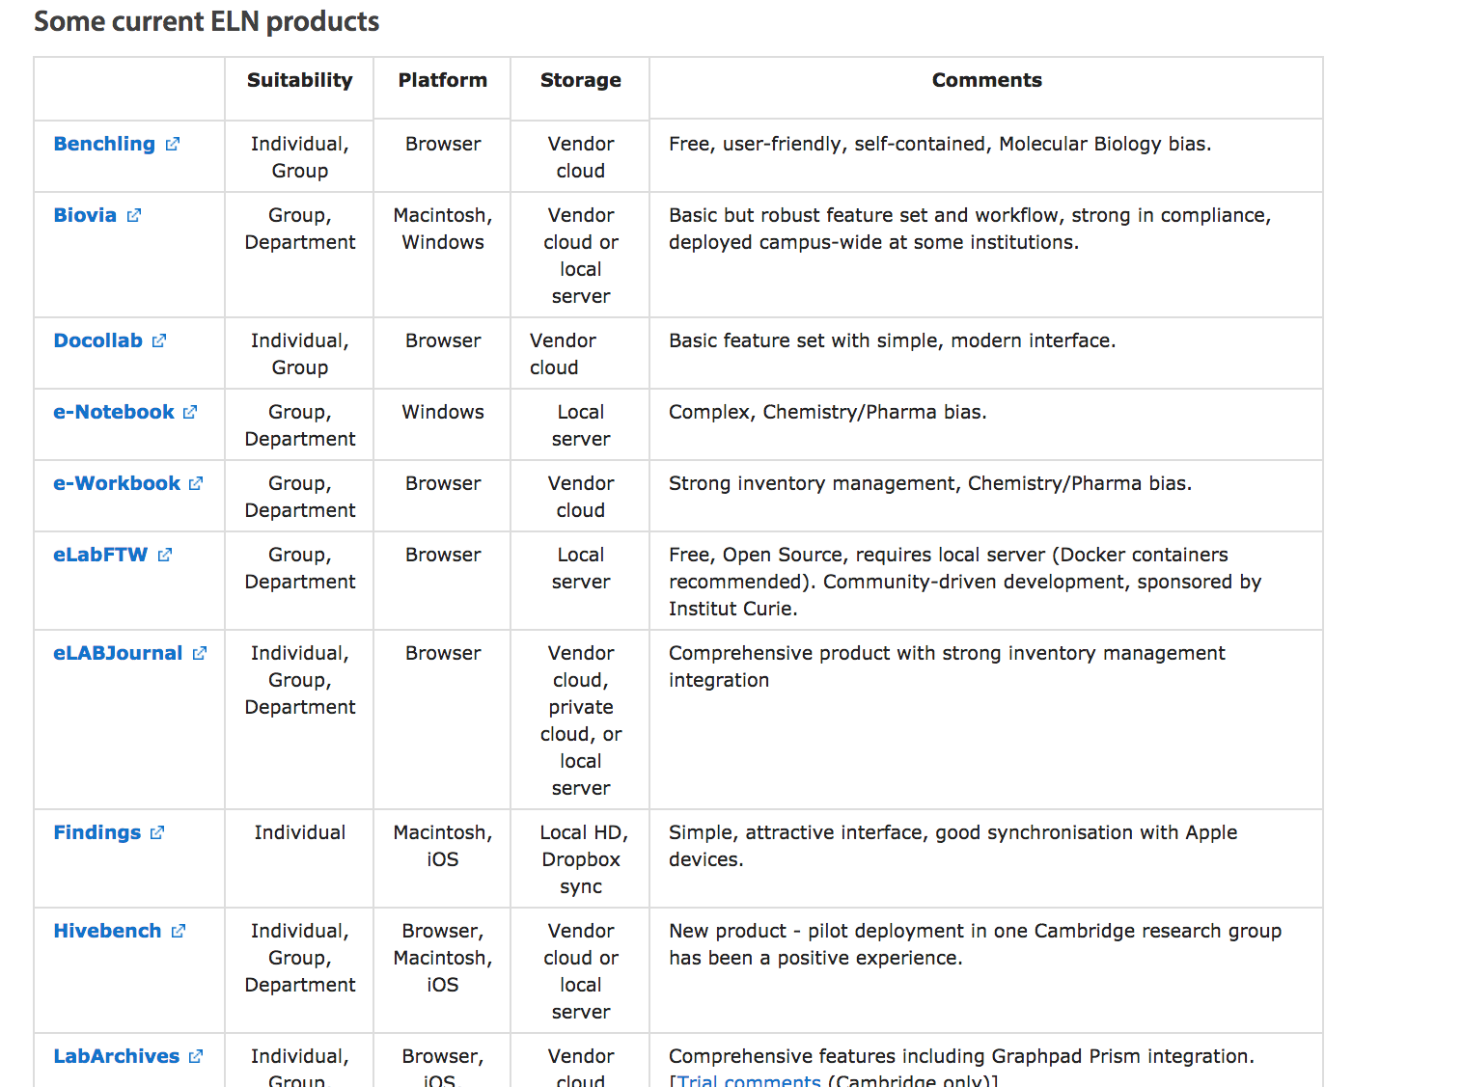
Data Management Checklist
Notes:
1.1 Data type and sources
- What types of data, samples, physical collections, code, software, curriculum materials
and other materials will be produced in the course of the project?
- including a brief description of each type of data to be generated, e.g. experimental,
qualitative, raw, processed
- Which data you will share and at what stage (raw, processed, reduced, analyzed)
- if you are using data from other sources, provide a brief description, including content,
source, any any conditions required for obtaining and using that data. If you combine existing
data with your own, describe the relationship between the data sets.

Slide 9
Formats: Data type and sources
File formats currently recommended by UK Data Archive for long term preservation for rsearch data
Notes:
Why file organization of your research data is important
Specific techniques for organizing your research data,
including developing plans for:
– File structures - where to put data so you won’t lose it
(including tips on embedding metadata)
– File naming - what to call data so you know what it is
– A bit on version control - keeping track of data
• Will also include opportunities for:
– Small group discussion
– Exercise for organizing your own data
• Focuses on research data, but applies to other types of files as well

Slide 10
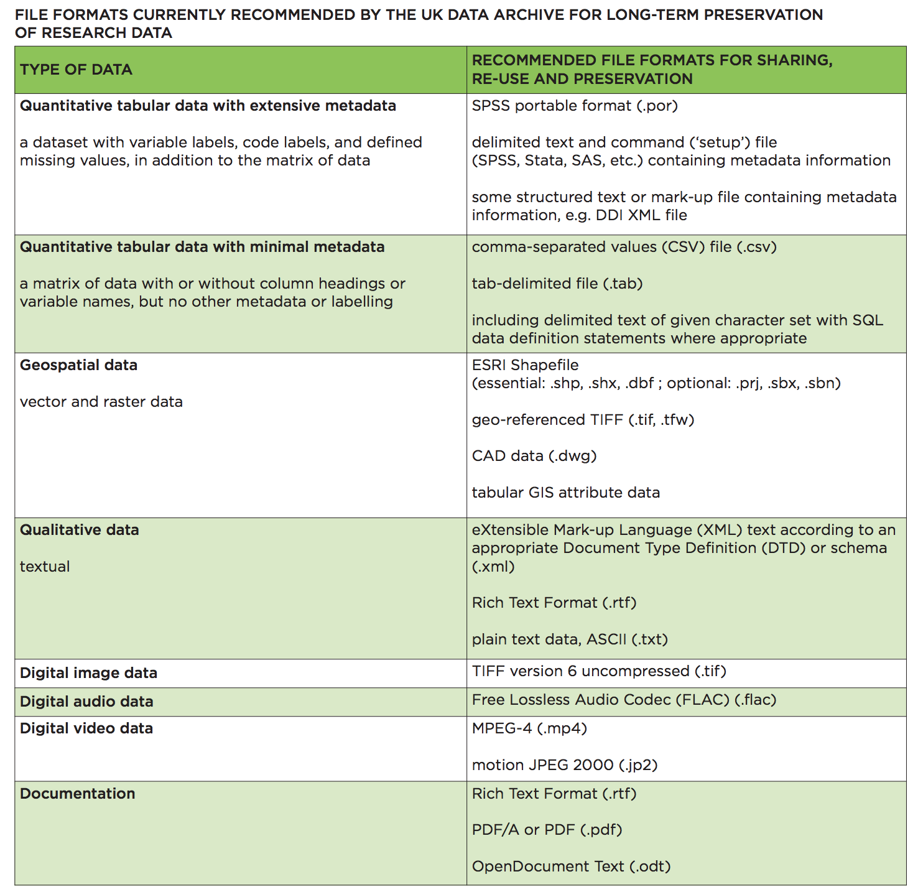
Notes:
Why file organization of your research data is important
Specific techniques for organizing your research data,
including developing plans for:
– File structures - where to put data so you won’t lose it
(including tips on embedding metadata)
– File naming - what to call data so you know what it is
– A bit on version control - keeping track of data
• Will also include opportunities for:
– Small group discussion
– Exercise for organizing your own data
• Focuses on research data, but applies to other types of files as well

Slide 11
File Naming Conventions
Make file names unique
Include most important identifying information of the project:
project name
acronym, or research data name
study title
location information
researcher initials
date (consistently formatted, e.g. YYYYMMDD)
version
Use underscores to separate elements; avoid special characters, spaces and periods.
Use leading zeros when incorporating numbers to enable sorting (a sequence of 1-100 should be numbered 001-100).
File names should be short enough to be readable, while still conveying enough pertinent information (limits 255 chars)
Notes:
Why file organization of your research data is important
Specific techniques for organizing your research data,
including developing plans for:
– File structures - where to put data so you won’t lose it
(including tips on embedding metadata)
– File naming - what to call data so you know what it is
– A bit on version control - keeping track of data
• Will also include opportunities for:
– Small group discussion
– Exercise for organizing your own data
• Focuses on research data, but applies to other types of files as well

Slide 12
File Naming Conventions Examples
The Good: DryValleySoil_ICPOES_20101115_JDSv2.dat
DryValleySoil, project name
ICPOES, instrument name
20101115 date of sample created
JDS, initials of the scientist
V2, second version
The Bad: my Data @DryValley November 15 2010.v2.dat
The Ugly:
Can you understand/use these data files? Would anyone 5 years from now?
• SrvMthdDraft.doc
• SrvMthdFinal.doc
• SrvMthdLastOne.doc
• SrvMthdRealVersion.doc
Use content-or descriptive information
Notes:
content-specific or descriptive information

Slide 13
Batching Renaming Tools
Windows:
• Adobe Bridge (via any Creative Cloud products): http://ist.mit.edu/adobe-creative-cloud
• Ant Renamer: http://www.antp.be/software/renamer
• Bulk Rename Utility: http://www.bulkrenameutility.co.uk/
• ImageMagick: http://www.imagemagick.org/
• PSRenamer: http://www.powersurgepub.com/products/psrenamer.html
• RenameIT: http://sourceforge.net/prpjects/renameit
Mac:
• Adobe Bridge (via any Creative Cloud products): http://ist.mit.edu/adobe-creative-cloud
• ImageMagick: http://www.imagemagick.org/
• Name Changer: http://web.mac.com/mickeyroberson/MRR_Software/NameChanger.html
• PSRenamer: http://www.powersurgepub.com/products/psrenamer.html
• Renamer4Mac : http://renamer4mac.com/
• Name Mangler: http://manytricks.com/namemangler/
Linux:
• GNOME Commander: http://www.nongnu.org/gcmd/
• GPRename: http://gprename.sourceforge.net/
• ImageMagick: http://www.imagemagick.org/
• PSRenamer: http://www.powersurgepub.com/products/psrenamer.html
Unix
• The use of the grep command to search for regular expressions
Notes:
Why file organization of your research data is important
Specific techniques for organizing your research data,
including developing plans for:
– File structures - where to put data so you won’t lose it
(including tips on embedding metadata)
– File naming - what to call data so you know what it is
– A bit on version control - keeping track of data
• Will also include opportunities for:
– Small group discussion
– Exercise for organizing your own data
• Focuses on research data, but applies to other types of files as well

Slide 14
Version Control
Aim: Keep raw data untouched and reverse to earlier version
Save an untouched copy of the raw data, work on save untouched copy
Use a file naming convention (like v001, v002 or v1_0, v1_2, v2_0
Use a directory structure naming convention that includes version information
Date can be part of the file name, e.g.
2012-02-27_Template_soil _testing.xlsx
Append the author’s name to the file name, e.g.
Template_soil _testing_modified_by_AH.xlsx
Add a version number after reach major edit, e.g.
Template_soil _testing_v03.xlsx
Directory top-level folders should include the project title, unique identifier, and date (year), but the files themselves should be well-described independent of the directory structure.
Version control tools:
Wet lab: Electronic Lab Notebooks/Box/LIMS
Dry lab: SVN/GitHub
Notes:
Why file organization of your research data is important
Specific techniques for organizing your research data,
including developing plans for:
– File structures - where to put data so you won’t lose it
(including tips on embedding metadata)
– File naming - what to call data so you know what it is
– A bit on version control - keeping track of data
• Will also include opportunities for:
– Small group discussion
– Exercise for organizing your own data
• Focuses on research data, but applies to other types of files as well

Slide 15
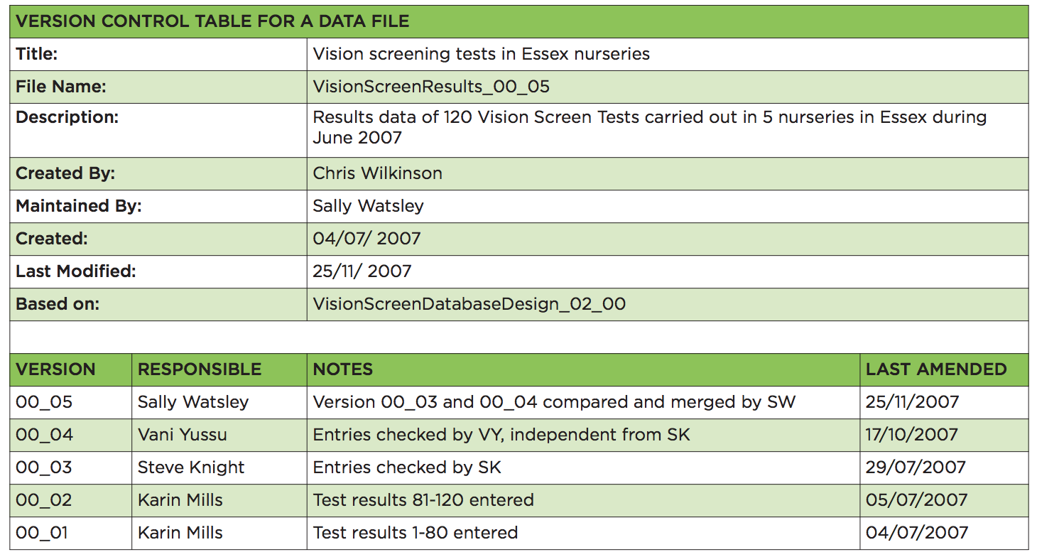
Version Control Example
Notes:
Why file organization of your research data is important
Specific techniques for organizing your research data,
including developing plans for:
– File structures - where to put data so you won’t lose it
(including tips on embedding metadata)
– File naming - what to call data so you know what it is
– A bit on version control - keeping track of data
• Will also include opportunities for:
– Small group discussion
– Exercise for organizing your own data
• Focuses on research data, but applies to other types of files as well

Slide 16
Folder Structure
Methods of organising electronic material
Hierarchical: Items organised in folders and sub-folders
Tag-based: Each item assigned one or more tags
Hybrid combination of hierarchical and tag-based
Notes:
Why file organization of your research data is important
Specific techniques for organizing your research data,
including developing plans for:
– File structures - where to put data so you won’t lose it
(including tips on embedding metadata)
– File naming - what to call data so you know what it is
– A bit on version control - keeping track of data
• Will also include opportunities for:
– Small group discussion
– Exercise for organizing your own data
• Focuses on research data, but applies to other types of files as well

Slide 17
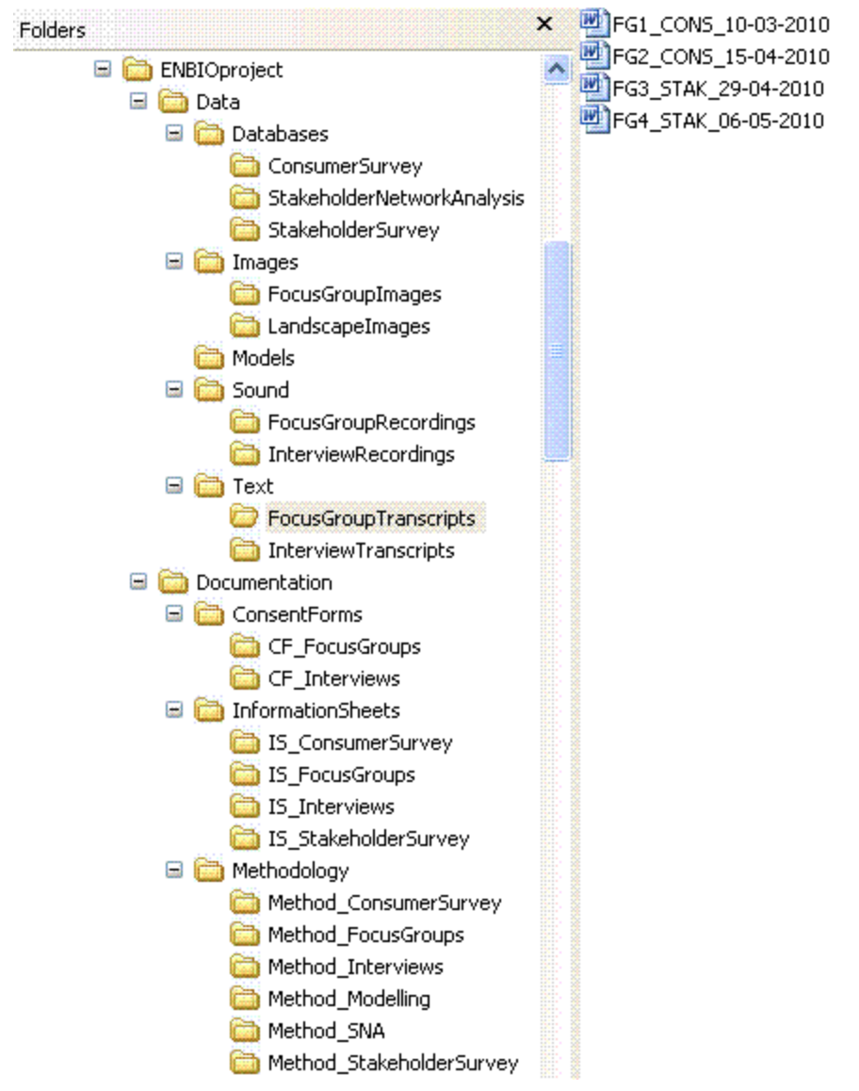
Folder Structure Examples – Hierarchical
Notes:
benefits
• Familiar and widely used
• Good at representing the structure of
information
– Constructing the hierarchy can itself be a helpful
exercise
• Similar items are stored together
• Sub-folders can function as task lists
• Great for location-based finding
12
Hierarchical systems: drawbacks
• Surprisingly hard work to set up and maintain
– ‘a heavyweight cognitive activity’
• Can be hard to get the right balance between
breadth and depth
• Items can only go in one place
• Time consuming to reorganise if the hierarchy
becomes out of date
Tips for managing a hierarchical
system
• In Windows, Windows Explorer is a good tool
• If possible, avoid overlapping categories
– Find other ways of linking items
• Don’t let your folders get too big – or
your structure get too deep
– Create separate folders for older (no longer
active) material

Slide 18
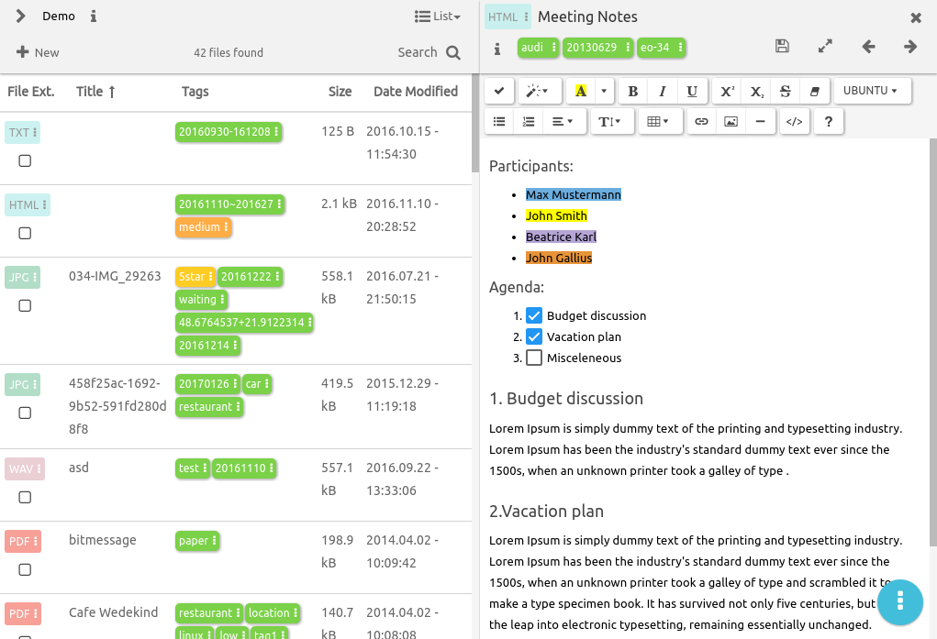
Folder Structure Examples – Tag-based
Notes:
Tag-based systems: benefits
• Items can go in more than one category
– Moreover, multiple types of category can be used
• Many people find tagging quicker and easier
than hierarchical filing
• When collaborating, can be easier to combine
than hierarchical systems
14
Tag-based systems: drawbacks
• Not how operating systems store files
• If material isn’t tagged properly when first
acquired, it can be hard to find later
• There’s a risk of inconsistent tagging
• And of similarly named categories getting
mixed
• Less good at representing the structure of
information
Creating a tag-based system
• Possible tools include:
• Bibliographic software
– EndNote, Zotero, Mendeley...
• Image management programs
– Flickr, Picasa...
• Google tools
• See our guide to Tagging and Finding Your
Files: http://libguides.mit.edu/metadataTools/

Slide 19
Small Group Discussion
What sort of structure(s) do you currently use?
What do you see as the key advantages and disadvantages of the different types of system?
Are there specific tasks one sort of system seems particularly suitable for? How does this apply to your research project?
Notes:
Why file organization of your research data is important
Specific techniques for organizing your research data,
including developing plans for:
– File structures - where to put data so you won’t lose it
(including tips on embedding metadata)
– File naming - what to call data so you know what it is
– A bit on version control - keeping track of data
• Will also include opportunities for:
– Small group discussion
– Exercise for organizing your own data
• Focuses on research data, but applies to other types of files as well

Slide 20
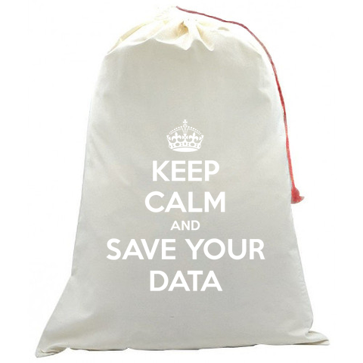
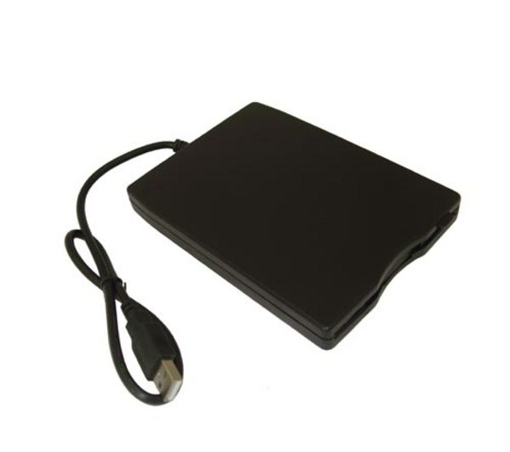
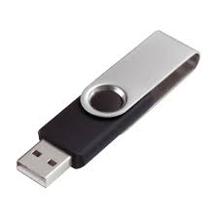
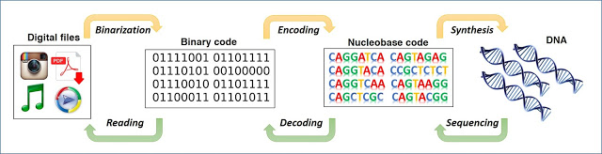
Data Storage
The everlasting external disks
Are they really permanent? What if…
Notes:
Why file organization of your research data is important
Specific techniques for organizing your research data,
including developing plans for:
– File structures - where to put data so you won’t lose it
(including tips on embedding metadata)
– File naming - what to call data so you know what it is
– A bit on version control - keeping track of data
• Will also include opportunities for:
– Small group discussion
– Exercise for organizing your own data
• Focuses on research data, but applies to other types of files as well

Slide 21

What if your data is lost
Cancer Research UK – University of Manchester – 27 April 2017
Notes:
Why file organization of your research data is important
Specific techniques for organizing your research data,
including developing plans for:
– File structures - where to put data so you won’t lose it
(including tips on embedding metadata)
– File naming - what to call data so you know what it is
– A bit on version control - keeping track of data
• Will also include opportunities for:
– Small group discussion
– Exercise for organizing your own data
• Focuses on research data, but applies to other types of files as well

Slide 22

What if your data is lost
Your laptop got stolen
Your office/house burnt
Your USB stick is lost
Your portable hard disk is damaged
Data copied to Dropbox disappeared
https://en.wikipedia.org/wiki/The_Scream
Notes:
Why file organization of your research data is important
Specific techniques for organizing your research data,
including developing plans for:
– File structures - where to put data so you won’t lose it
(including tips on embedding metadata)
– File naming - what to call data so you know what it is
– A bit on version control - keeping track of data
• Will also include opportunities for:
– Small group discussion
– Exercise for organizing your own data
• Focuses on research data, but applies to other types of files as well

Slide 23

Storage + Security + Encryption + Backup + Sharing
https://en.wikipedia.org/wiki/The_Scream
Notes:
Why file organization of your research data is important
Specific techniques for organizing your research data,
including developing plans for:
– File structures - where to put data so you won’t lose it
(including tips on embedding metadata)
– File naming - what to call data so you know what it is
– A bit on version control - keeping track of data
• Will also include opportunities for:
– Small group discussion
– Exercise for organizing your own data
• Focuses on research data, but applies to other types of files as well

Slide 24

Storage + Security + Encryption + Backup + Sharing
https://en.wikipedia.org/wiki/The_Scream
Notes:
Why file organization of your research data is important
Specific techniques for organizing your research data,
including developing plans for:
– File structures - where to put data so you won’t lose it
(including tips on embedding metadata)
– File naming - what to call data so you know what it is
– A bit on version control - keeping track of data
• Will also include opportunities for:
– Small group discussion
– Exercise for organizing your own data
• Focuses on research data, but applies to other types of files as well

Slide 25

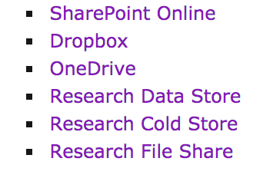

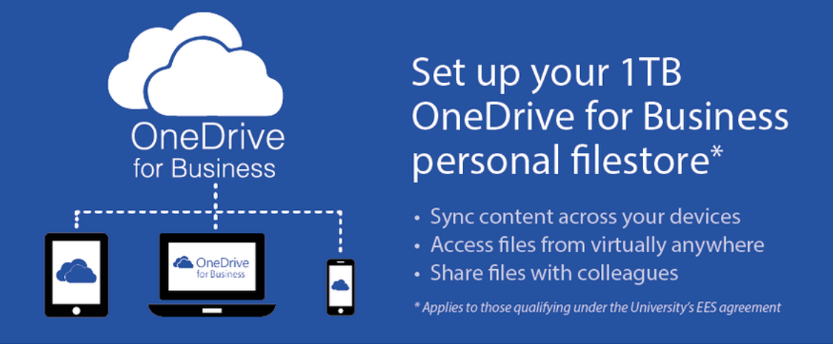
Storage + Security + Encryption + Backup + Sharing
University Storage Service
CRUK CI IT
Lab
Individual (Time machine)
CLOUD?
https://en.wikipedia.org/wiki/The_Scream
Notes:
Why file organization of your research data is important
Specific techniques for organizing your research data,
including developing plans for:
– File structures - where to put data so you won’t lose it
(including tips on embedding metadata)
– File naming - what to call data so you know what it is
– A bit on version control - keeping track of data
• Will also include opportunities for:
– Small group discussion
– Exercise for organizing your own data
• Focuses on research data, but applies to other types of files as well

Slide 26

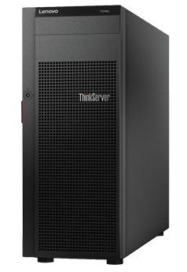




Data Backup
At least 2 backups at 2 different locations
External disks
Online backup
Servers
Department
College
IT
Cheap
£10-15 / TB (1024GB)
Accessibility
Free (limit)
Managed by experts
Failure rate
1.5%/year
Personal data
Hacking
Moving between institutions

Slide 27

Data Backup
Manual
Automated
- Install software
e.g. Time machine (Mac users)
Copying files to relevant folders
- RAID technology
- Checksums
Automatically upload files to the cloud when any changes are saved
Copying files to relevant folders

Slide 28
Data backup and file sharing
Space/price
2 GB (free)
Unlimited (£55/year)
15 GB (free)
1 TB (~£80/year)
1 TB (free)
File history and recovery
Yes, unlimited
Yes
Last 90 days
File size limit
None
5 GB
15 GB
Support
UIS
Unsupported
UIS
OS
Windows, Mac, Linux,
Android, iOS
Windows, Mac,
Android, iOS
Windows, Mac,
Android, iOS
Accessibility
Sync anywhere on any devices
Live editing
Integration with Microsoft Office

Slide 29



Data Backup
Q: If manual ... how often?
A: How much would you be willing to lose?
Software allows you to set up backup time automatically
1 day
1 week
1 month-year

Slide 30



More … file sharing
Email
Website
FTP

